Slide 1


TOP LinkedIN Skills for 2016
Country Ranking By Skill

Slide 2
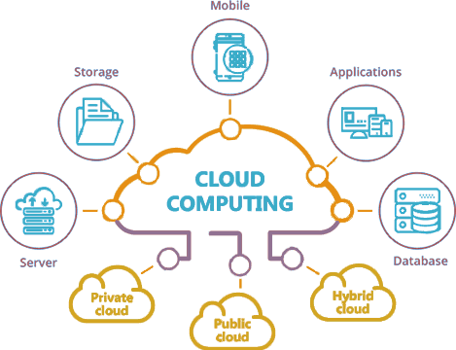
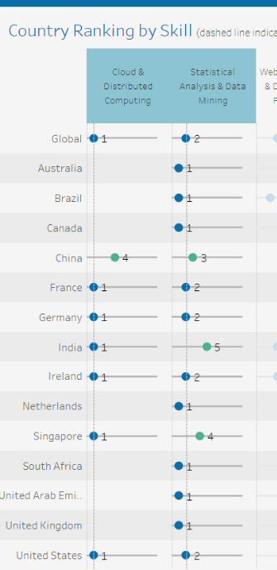

1.CLOUD COMPUTING & DATA PROFESSIONALS are WorkForce Rockstars -> These jobs are very in demand.
** The visualization below shows that nations like Germany, France , US, Singapore & Ireland are the major players at both.
Cloud services are very much prevalent in all aspects of today’s businesses. It’s no wonder that they are on top. A very strong second is ‘data mining & statistical skills’. As they say, “data is the new oil”. One of the many reasons why we have this tableau file and this course exists: data mining skills are in demand.

Slide 3
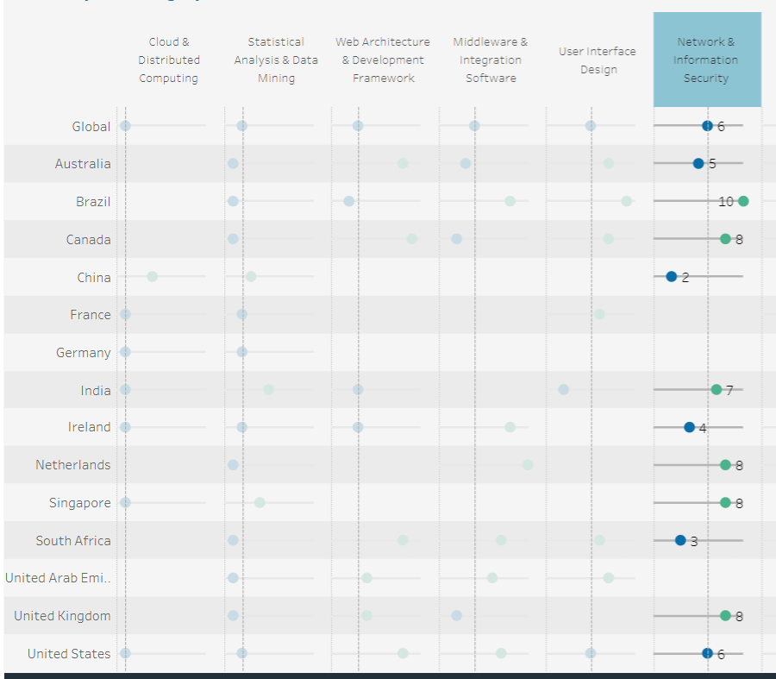

2nd Insight: Cyber Security is growing BUT not as strong as a decade before. ** I derived this data by simply choosing the ‘Network & Information Security’ tabs and based the comparisons with other industries; per country
It is VERY INTERESTING to note than network & information security only placed 6th over all. It is also quite noticing that countries like Germany, France & UAE did not show interest nor traction in the security industry. A good hypothesis from my perspective is that the top 2 fields; cloud computing & data mining gained a LOT of traction and ‘promotion’ in the past decade or so. Hence there was a very strong competition among talents, recruiters organizations & even governmental agencies.

Slide 4
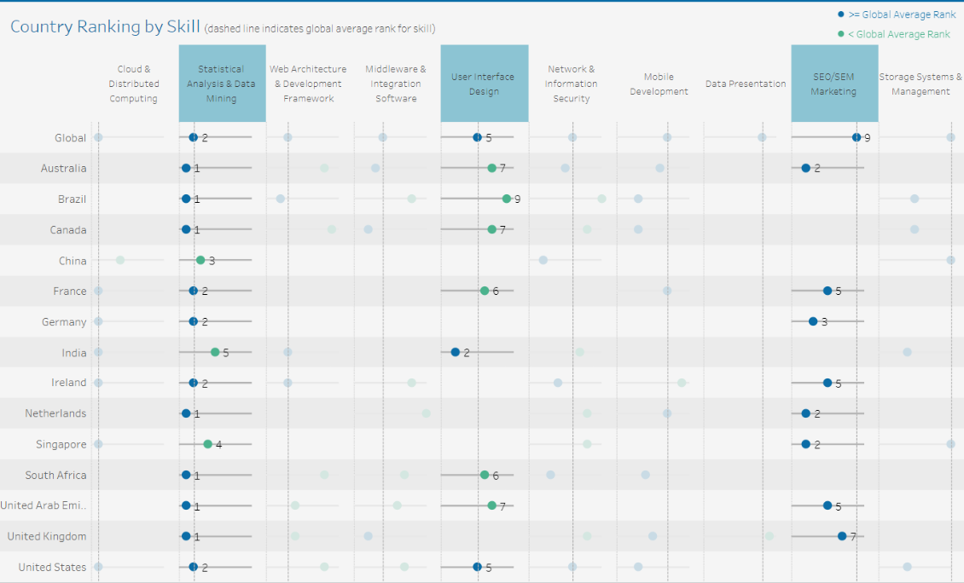
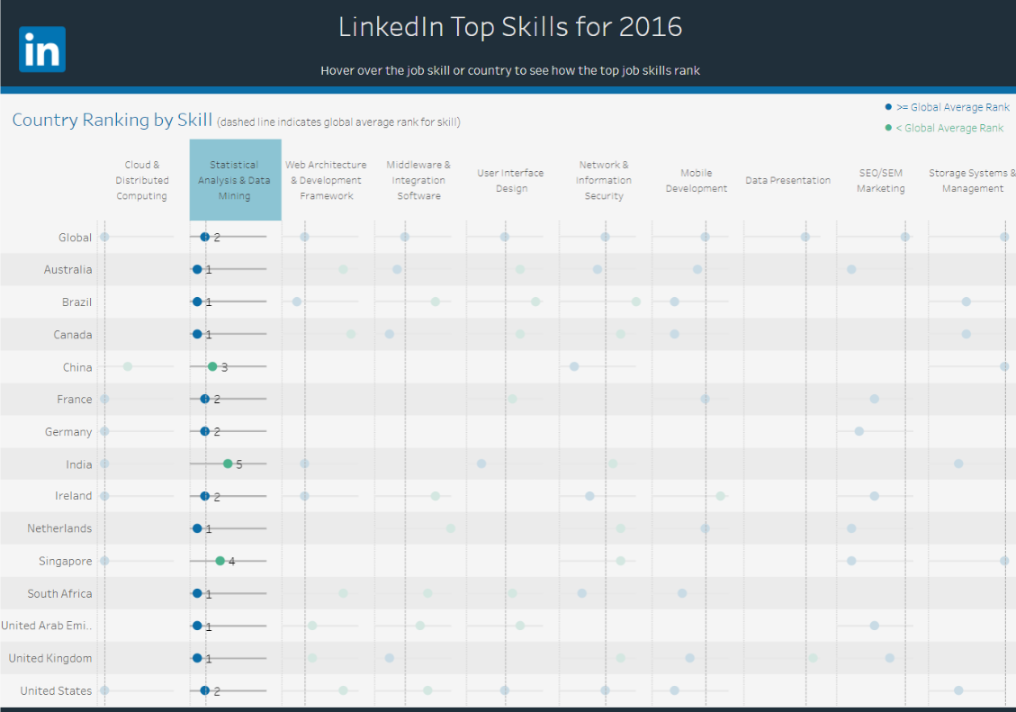
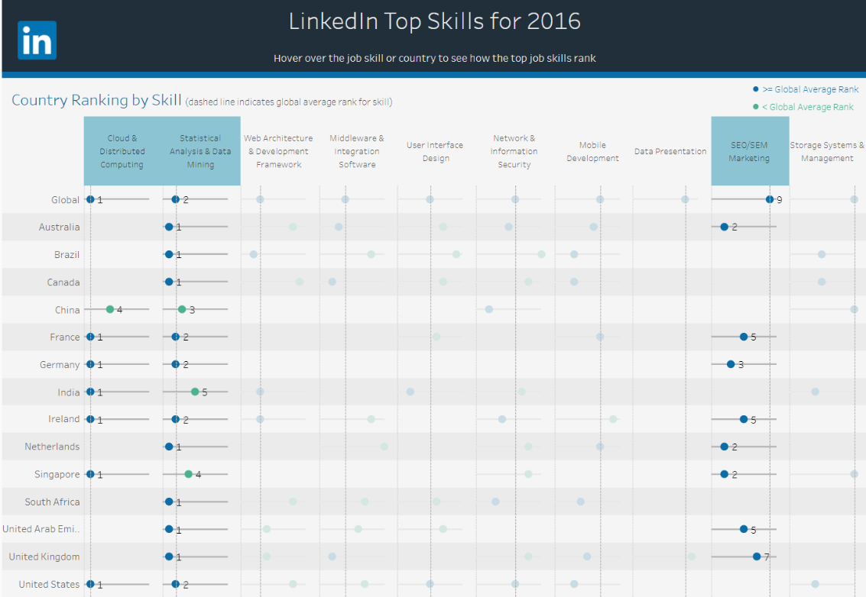
The 3rd Insight: Over-All Skills Interdependency ** Explanations on the following slide

Slide 5


Skills Interdepence: Explained The skills presented in the 3 graphs above shows the heavy dependence on both cloud and ‘data-related sciences & methodologies’
This all makes sense since almost all applications have moved to the cloud. Also, popular and trending skills/industries like UI/UX design, SEO/SEM all rely heavily on data. Such skill sets requires some form of knowledge on data.

Slide 6

Skills Evolution & a T-Shaped Careers-Person Based on the fundamental insights from the graphs, it is vital to appreciate that there will always be INTERDEPENCE. It’s just how technology & organizations do operate. This would further strengthen ‘cross training’ & lifelong learning among employees.

